Slide 1

Shipping Association of Guyana (SAG)
LEADERS IN ADVOCACY FOR THE SHIPPING INDUSTRY

Slide 2


Slide 3


Slide 4
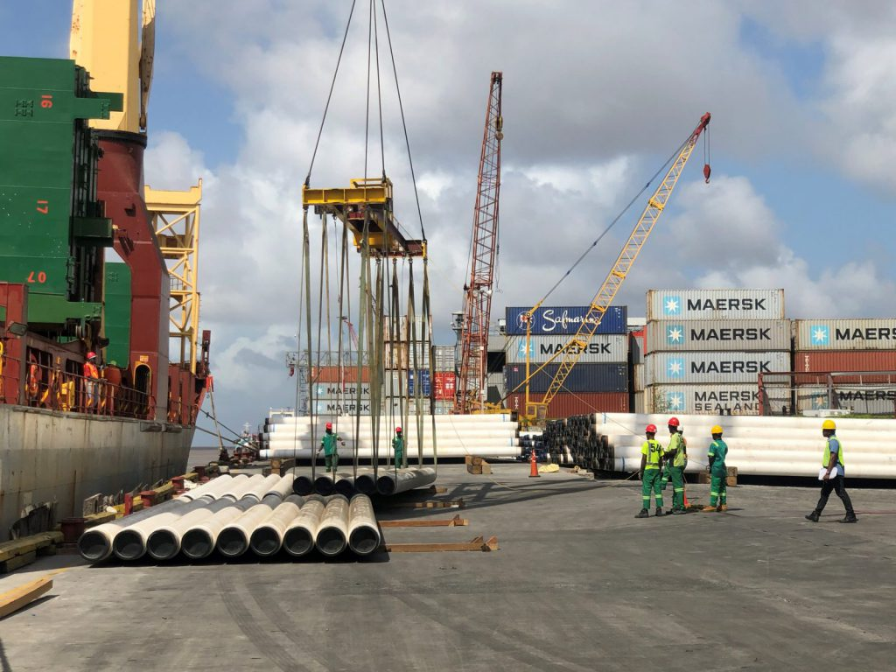
WHO WE ARE
The Shipping Association of Guyana (SAG) is a non-governmental organization that serves as the advocate for the entire shipping industry in Guyana. We represent the interest of all operators including:-
Ship owners
Shipping Agents
Terminal Operators
Transportation/
Logistic Operators

Slide 5
WHO WE ARE CONT’D
SAG acts as the liaison between operators and relevant government agencies, especially the Maritime Administration Department (MARAD). The Association is now recognized as the institution responsible for consultations with relevant agencies for improved infrastructure, re-framing laws and requirements regarding all aspects of shipping.
SAG is the bona-fide representative in Guyana of the Caribbean Shipping Association.

Slide 6
OUR MISSION
Through dynamic Leadership and Advocacy, SAG actively represents the interests of its members, clients, stakeholders and all other operators at local, regional and international levels, ensuring the highest standards of efficiency to facilitate movement of imports and exports and maximize national economic growth.

Slide 7
OUR OBJECTIVES
SAG is now better equipped to provide and/or facilitate quality training for our membership.
We aim to: Ensure shipping agencies comply fully with international Conventions and Regulations, and adopt safer, environmentally sound shipping practices.
To instill unity of purpose at all levels and to action all issues that come before us which are relevant to Guyana’s maritime transportation sector.

Slide 8

OUR OBJECTIVE CONT’D
To transform into financially self-sustaining organization by consistently increasing membership.
To consistently provide members and stakeholders with relevant information and guidance especially about technological advancement and new local and international matters in shipping.

Slide 9

OUR MANAGEMENT
TRUSTEES
Dr. Desmond Sears
Mr. Andrew Astwood
Mr. Richard VanSlytman
MANAGEMENT COMMITTEE
Chairman – Mr. Komal Singh
Vice Chairman- Mr. Allan Newark

Slide 10
OUR MANAGEMENT
COMMITTEE MEMBERS
Ms. Glenis Hodge
Mr. Hayley Gilbert
Mr. Gidel Thomside
Mr. Gobin Persaud
Ms. Jennifer Prashad
Mr. Sachin Prittipaul
Mr. Chandradat Chintamani
Ms. Nalini Jamuna
Immediate Past Chairman - Mr. Philip Fernandes

Slide 11
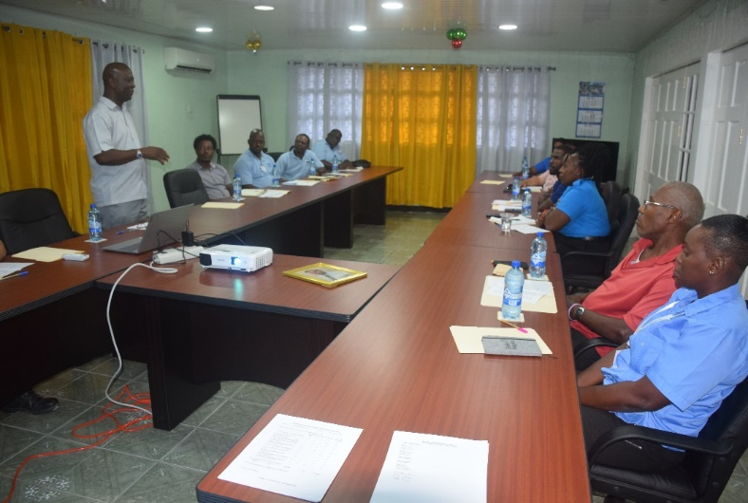
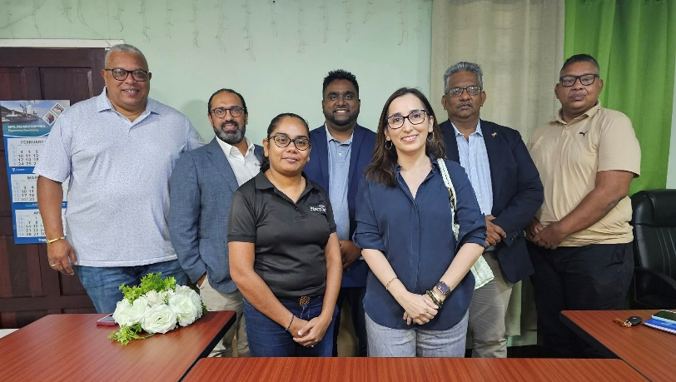
MAJOR GOALS
Initiate and implement Skill Development and Awareness Training programmes.
Ensure Shipping operators comply with international regulations and conventions and adopt environmentally safer practices.
Strengthen Executive and Member commitments and enhance advocacy activities.
Diversify and expand our membership to include inland and coastal shipping/hauling operators
Establish research and responsiveness capabilities and build proficiency in information Technology.
Strengthen network capacity and public relations capabilities specifically to boost the Association’s image.

Slide 12
OUR MEMBERS
9. Demerara Sugar Terminals (Guysuco)
10. GAC Logistics & Shipping
11. GAICO Construction Inc. Dredging & Marine Dept.
12. Genesis Marine Guyana Inc.
13. Guyana Freight Services Inc.
14. Guyana National Industrial Co. Inc.
15. Guyana National Shipping Corporation Ltd
16. GUYWILLSHIP International
1. AFS Shipping Agency Inc.
2. BOSAI Minerals Group (Guyana) Inc.
3. C&V Caribbean Shipping Ltd.
4. CCA Guyana Inc.
5. CMA/CGM – GUYANA
6. D&J Shipping Services Ltd.
7. Demerara Shipping Co Ltd.
8. Delmur Co Ltd.

Slide 13
OUR MEMBERS
17. John Fernandes Ltd
18. J.S.B. Investments Inc.
19. Kestrel Guyana Inc.
20. Larparkan Trading (Guy) Co Ltd.
21. Muneshwers Ltd
22. Murals Logistics Agency
23. National Milling Company Ltd.
24. Non-Compulsory Pilotage Association
25. PAS Cargo Guyana
26. RAMPS Logistics
27. Regal Shipping & Crew Consultancy Inc.
28. SOREIDOM Guyana Inc.
29. Tropical Shipping
30. Sealand Surveys
31. Guyana Customhouse Brokers and Clerks Assoc.
32. Guyana Shore Base Inc.
33. Austin Maritime & Energy Services

Slide 14

OUR MEMBERS
34. Lall-Belcon (Guyana) Inc. 40.CKHL Shipping & Logistics Ltd.
35. EXXONMOBIL (Guyana) LTD. 41. Air Cargo Pack
36. NRG Holdings Inc. 42. Westzyde Marine Inc.
37. TLC Guyana Inc.
38. Dockyard (Guyana) Port Inc.
39. Mediterranean Shipping Company Guyana Inc. (MSC)
__________________________
SAG is an affiliate of the Caribbean
Shipping Association

Slide 15
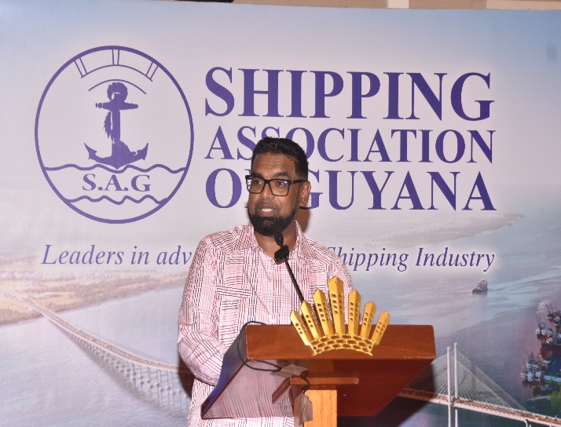
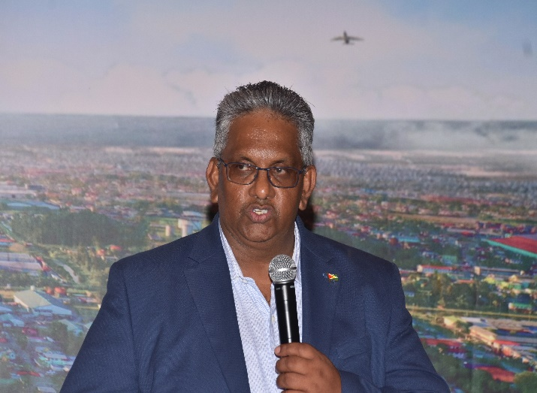
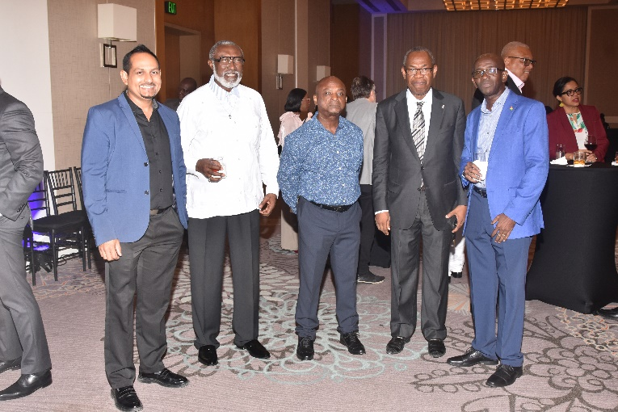


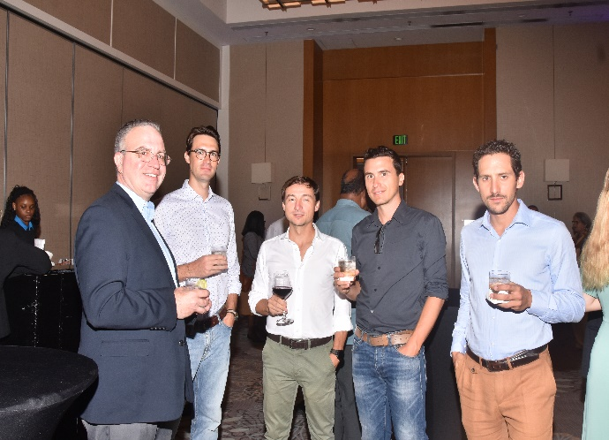
SAG SOCIAL EVENT

Slide 16
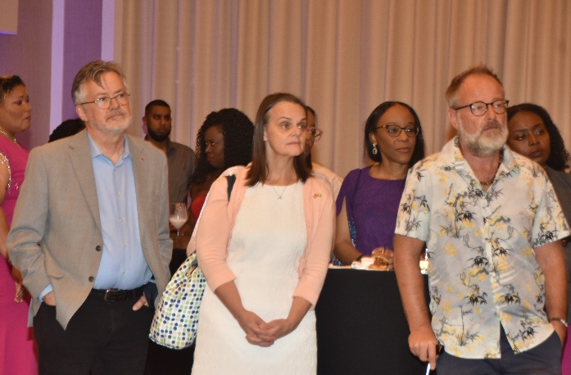
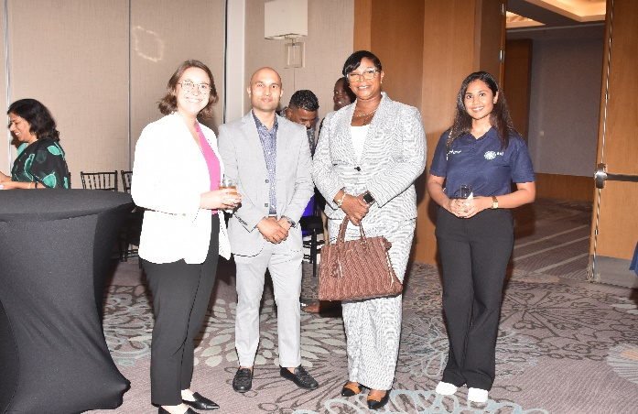

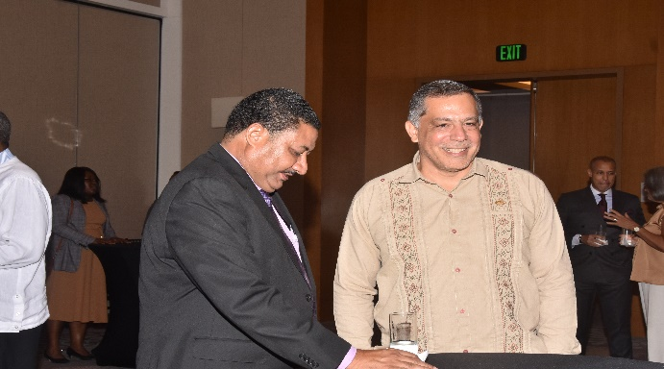


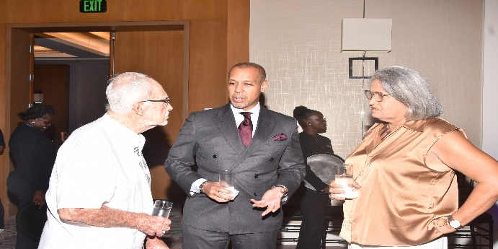
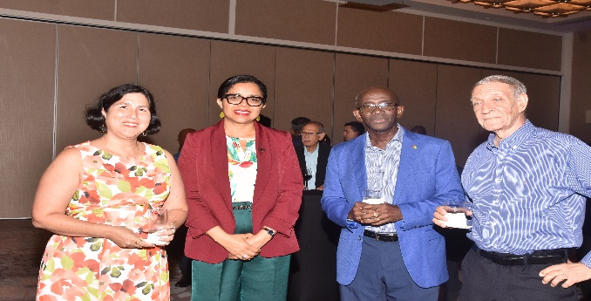


Slide 17



BECOME A MEMBER
CONTACT US:
SECRETARY/MANAGER
TEL: 592-226 2169 /Fax: 592-226 9656
EMAIL: saginc@networksgy.com
Lot 10-11 Lombard St., Werk-en-Rust, Georgetown, Guyana
Website: www.shipping.org.gy

Slide 18

SAVE THE DATE!

