Slide 1


Shipping Association of Guyana (SAG)
LEADERS IN ADVOCACY FOR THE
SHIPPING INDUSTRY

Slide 2


Slide 3
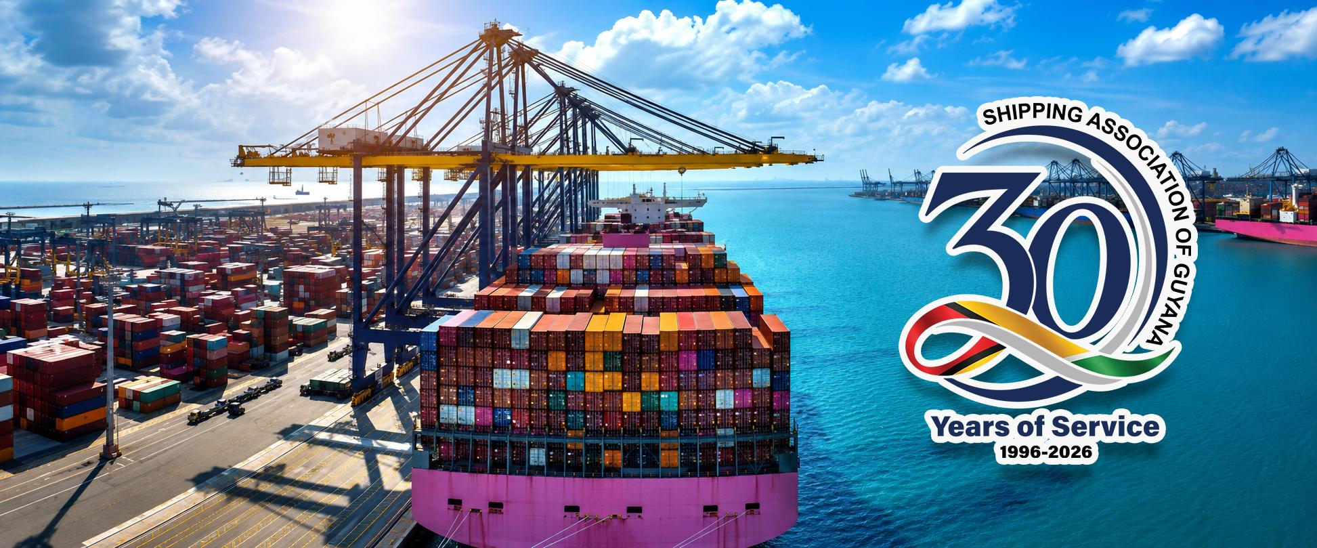

Slide 4
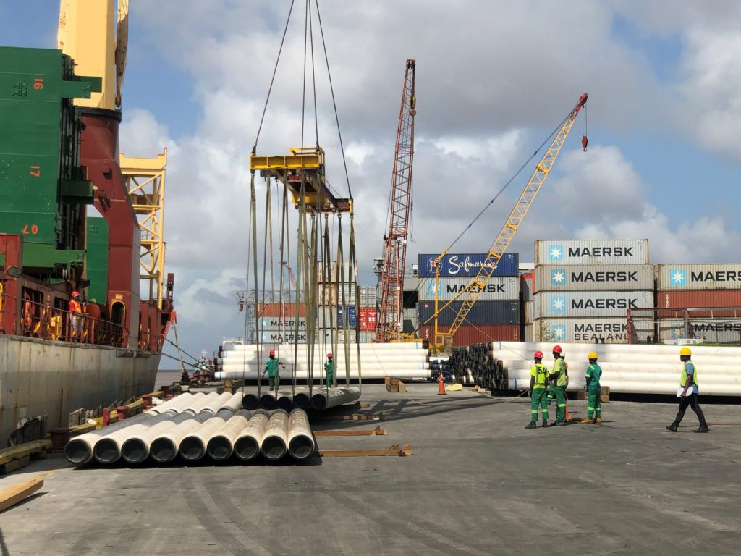
WHO WE ARE
The Shipping Association of Guyana (SAG) is a non-governmental organization that serves as the advocate for the entire shipping industry in Guyana. We represent the interest of all operators including:-
Ship owners
Shipping Agents
Terminal Operators
Transportation/
Logistic Operators

Slide 5
WHO WE ARE CONT’D
SAG acts as the liaison between operators and relevant government agencies, especially the Maritime Administration Department (MARAD) and Guyana Revenue Authority (GRA).
The Association is now recognized as the institution responsible for consultations with relevant agencies for improved infrastructure, re-framing laws and requirements regarding all aspects of shipping.
SAG is the bona-fide representative in Guyana of the Caribbean Shipping Association.

Slide 6
OUR MISSION
Through dynamic Leadership and Advocacy, SAG actively represents the interests of its members, clients, stakeholders and all other operators at local, regional and international levels, ensuring the highest standards of efficiency to facilitate movement of imports and exports and maximize national economic growth.

Slide 7
OUR OBJECTIVES
SAG is now better equipped to provide and/or facilitate quality training for our membership.
We aim to: Ensure shipping agencies comply fully with international Conventions and Regulations, and adopt safer, environmentally sound shipping practices.
To instill unity of purpose at all levels and to action all issues that come before us which are relevant to Guyana’s maritime transportation sector.

Slide 8

OUR OBJECTIVES CONT’D
To transform into financially self-sustaining organization by consistently increasing membership.
To consistently provide members and stakeholders with relevant information and guidance especially about technological advancement and new local and international matters in shipping.

Slide 9
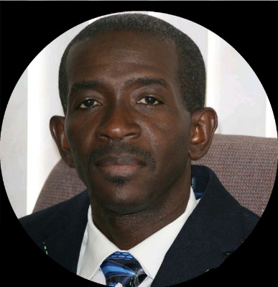

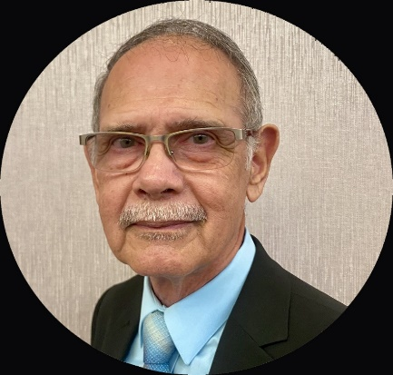
OUR MANAGEMENT
TRUSTEES
Mr. Andrew Astwood
Dr. Desmond Sears
Mr. Richard Van Slytman

Slide 10

Management Committee
Chairman – Dr. Komal Singh
Vice Chairman- Mr. Allan Newark
Mr. Philip Fernandes
Ms. Glenis Hodge
Ms. Hayley Gilbert
Mr. Gidel Thomside
Mr. Gobin Persaud
Ms. Jennifer Prashad
Mr. Sachin Prittipaul
Mr. Chandradat Chintamani
Ms. Nalini Jamuna

Slide 11
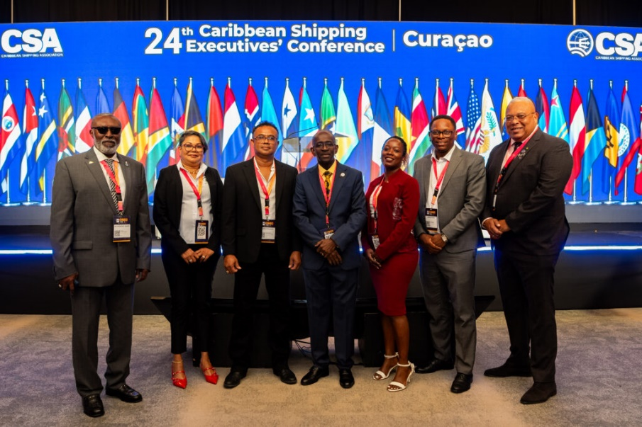

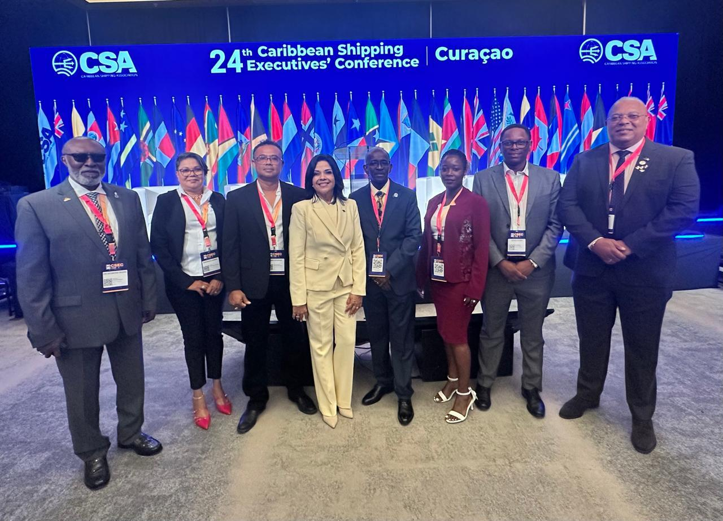

SAG represented at 24th CSA Executives Conference (CSEC) in Curacao May 17-19, 2026

Slide 12
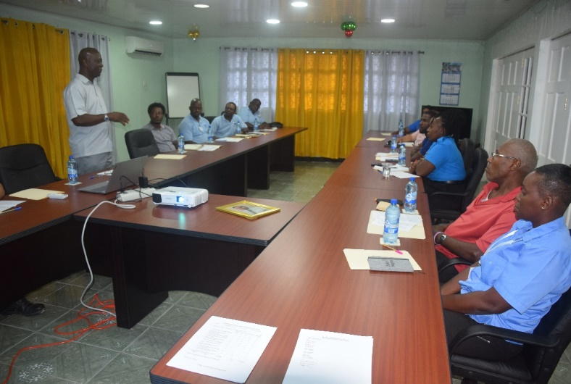
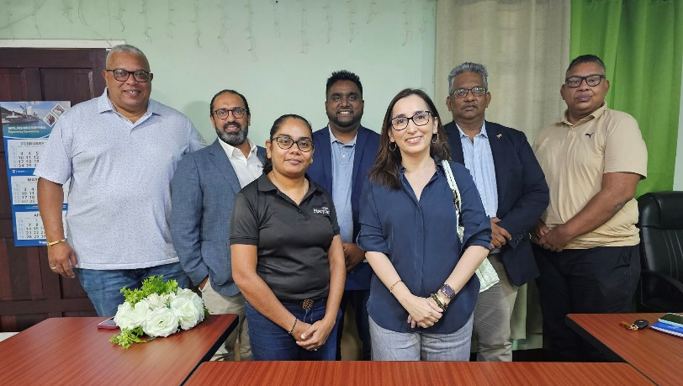
MAJOR GOALS
Initiate and implement Skill Development and Awareness Training programmes.
Ensure Shipping operators comply with international regulations and conventions and adopt environmentally safer practices.
Strengthen Executive and Member commitments and enhance advocacy activities.
Diversify and expand our membership to include inland and coastal shipping/hauling operators
Establish research and responsiveness capabilities and build proficiency in information Technology.
Strengthen network capacity and public relations capabilities specifically to boost the Association’s image.

Slide 13
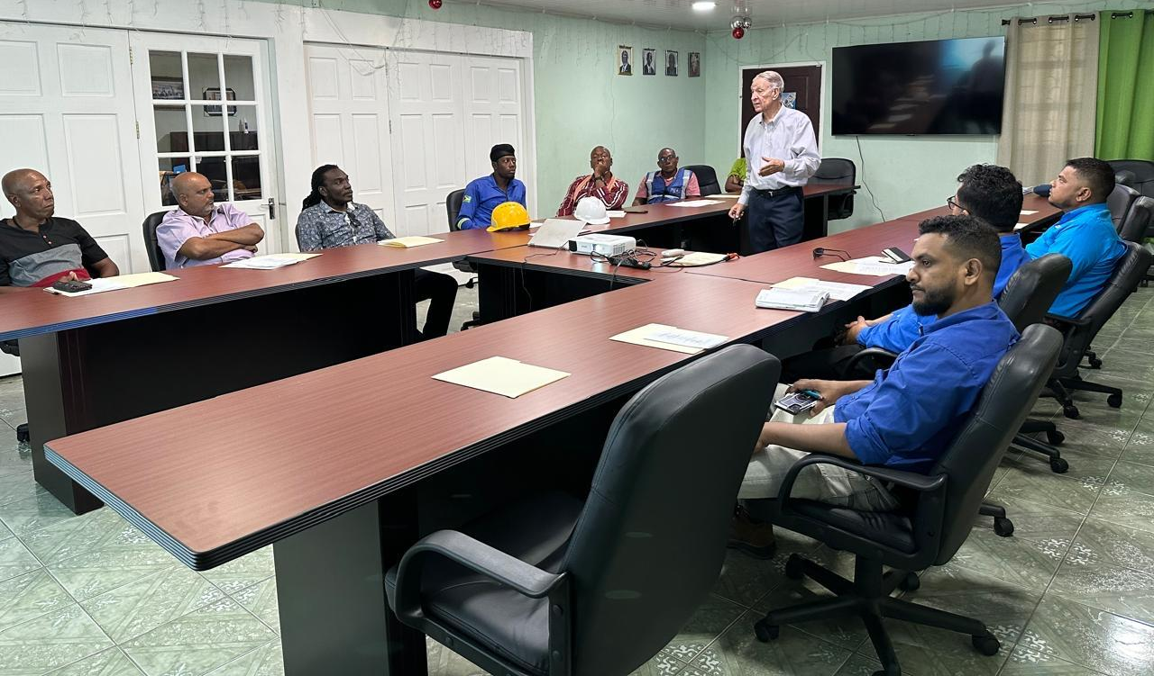
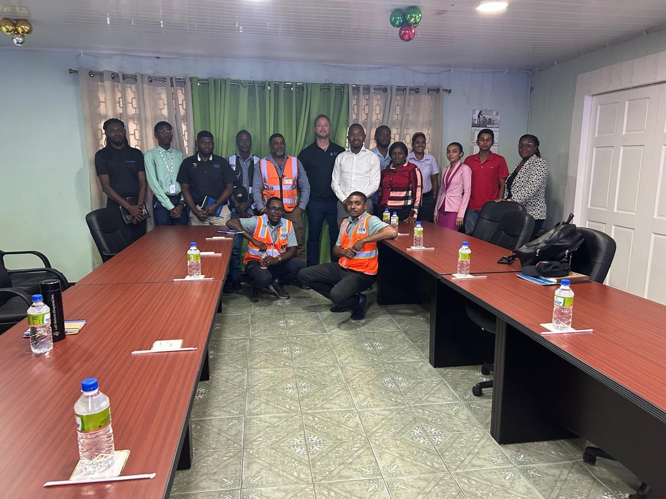
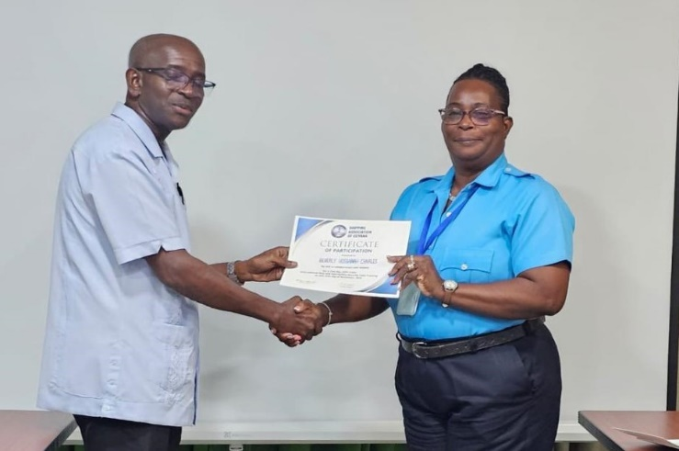
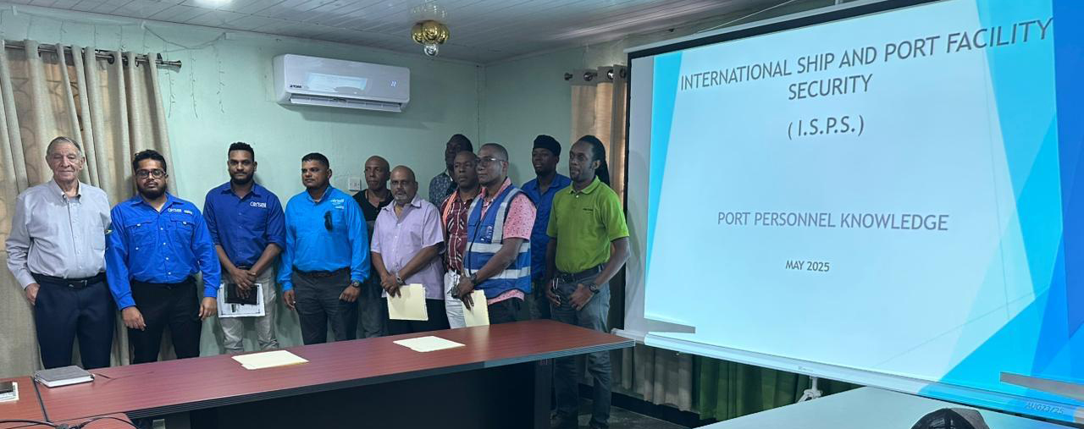
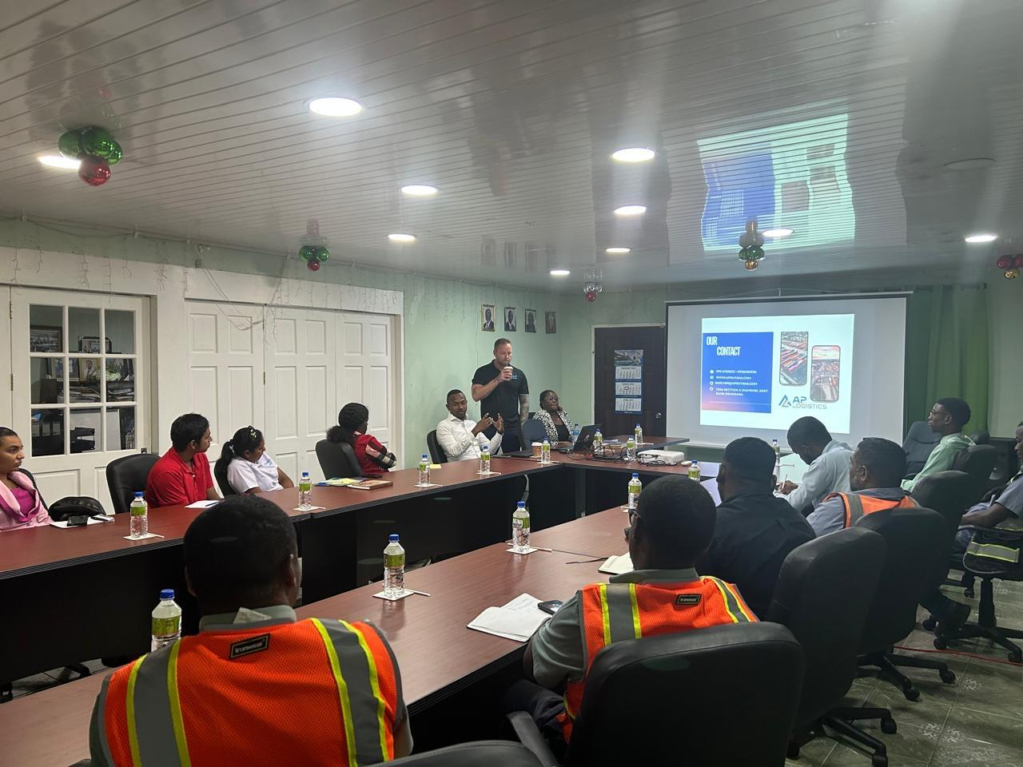
Training
Training and Development play an integral role in the sag’s mandate to it members

Slide 14
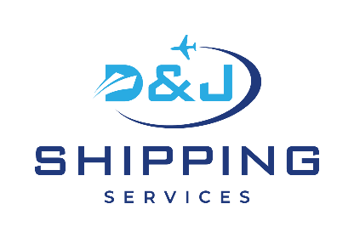
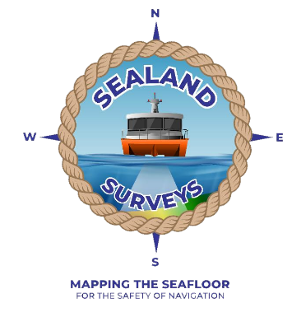

























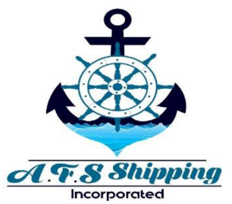



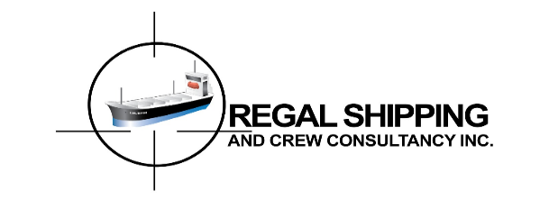







Slide 15
OUR MEMBERS
9. Demerara Sugar Terminals (Guysuco)
10. GAC Logistics & Shipping
11. GAICO Construction Inc.
12. Genesis Marine Guyana Inc.
13. Guyana Freight Services Inc.
14. Guyana National Industrial Co. Inc.
15. Guyana National Shipping Corporation Ltd
16. GUYWILLSHIP International
1. AFS Shipping Agency Inc.
2. BOSAI Minerals Group (Guyana) Inc.
3. C&V Caribbean Shipping Ltd.
4. CCA Guyana Inc.
5. CMA/CGM – GUYANA
6. D&J Shipping Services Ltd.
7. Demerara Shipping Co Ltd.
8. Delmur Co Ltd.

Slide 16
OUR MEMBERS
17. John Fernandes Ltd
18. J.S.B. Investments Inc.
19. Kestrel Guyana Inc.
20. Larparkan Trading (Guy) Co Ltd.
21. Muneshwers Ltd
22. Murals Logistics Agency
23. National Milling Company Ltd.
24. Non-Compulsory Pilotage Association
25. PAS Cargo Guyana
26. RAMPS Logistics
27. Regal Shipping & Crew Consultancy Inc.
28. SOREIDOM Guyana Inc.
29. Tropical Shipping
30. Sealand Surveys
31. Guyana Customhouse Brokers and Clerks Assoc.
32. Guyana Shore Base Inc.
33. Austin Maritime & Energy Services

Slide 17

OUR MEMBERS
34. Lall-Belcon (Guyana) Inc. 40.CKHL Shipping & Logistics Ltd.
35. EXXONMOBIL (Guyana) LTD. 41. Air Cargo Pack
36. NRG Holdings Inc. 42. Westzyde Marine Inc.
37. TLC Guyana Inc.
38. Dockyard (Guyana) Port Inc.
39. Mediterranean Shipping Company Guyana Inc. (MSC)
__________________________
SAG is an affiliate of the Caribbean
Shipping Association

Slide 18
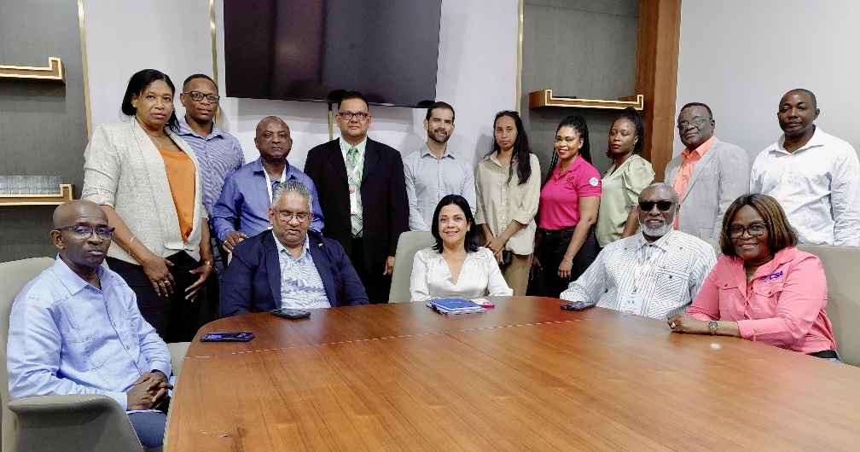
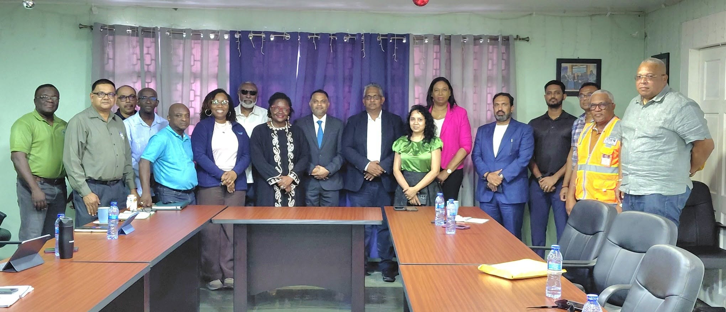


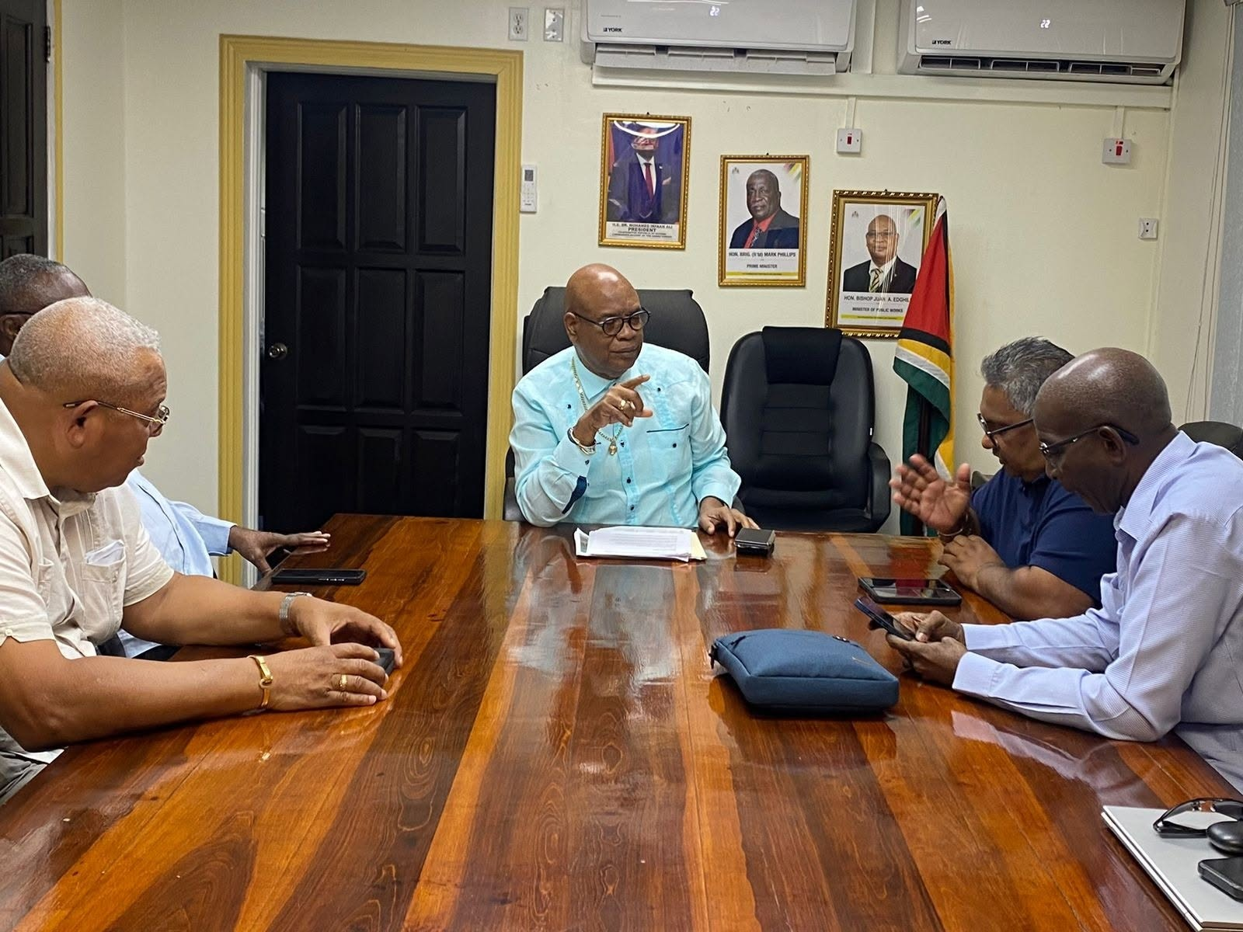
NETWORKING

Slide 19

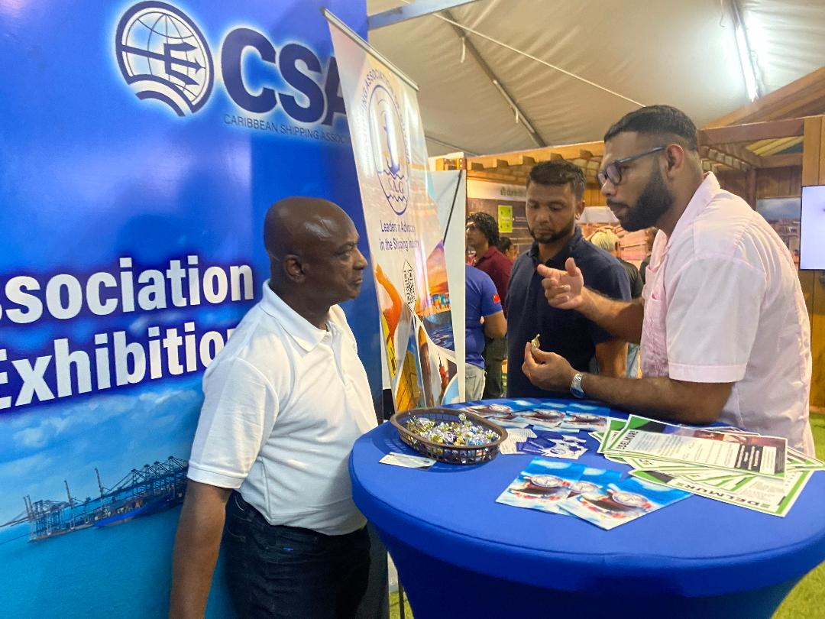
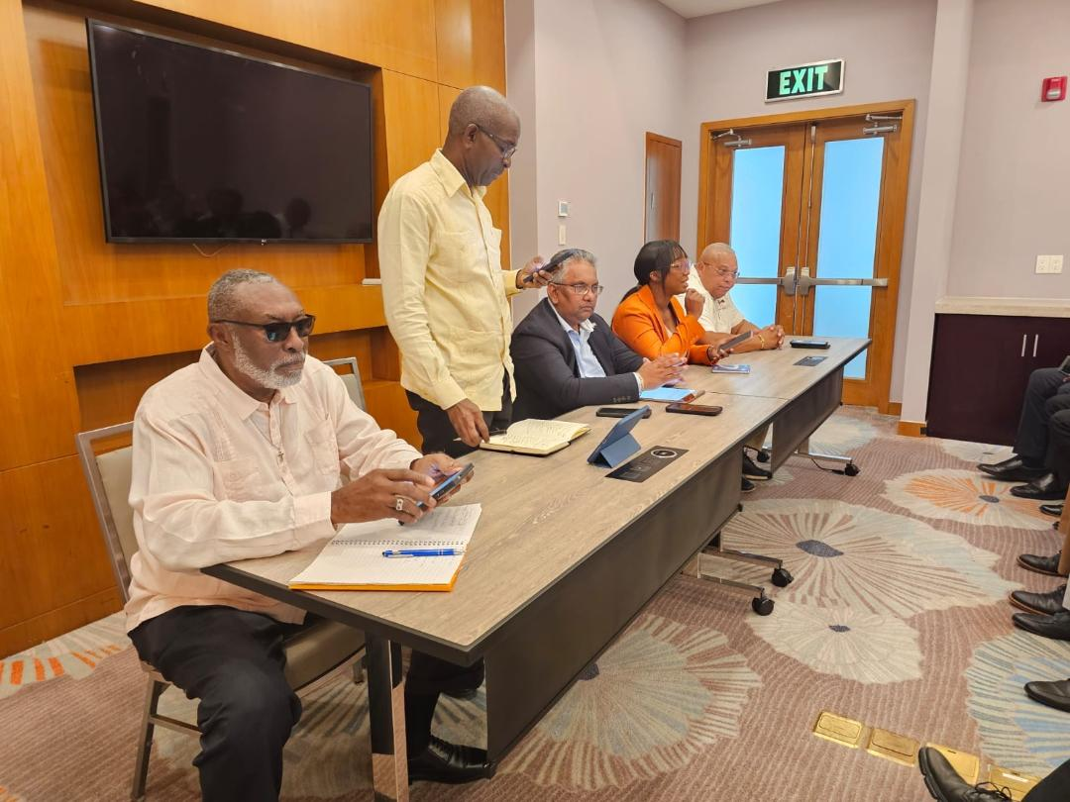
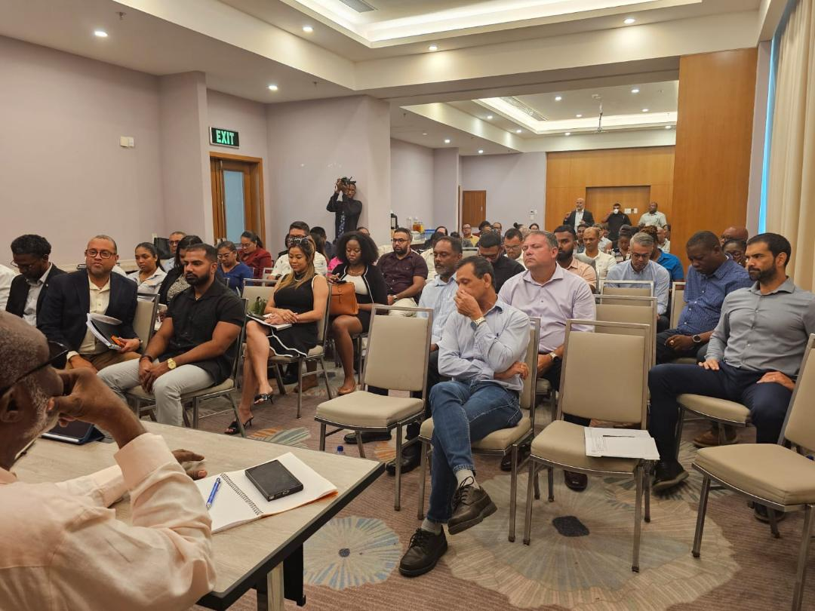
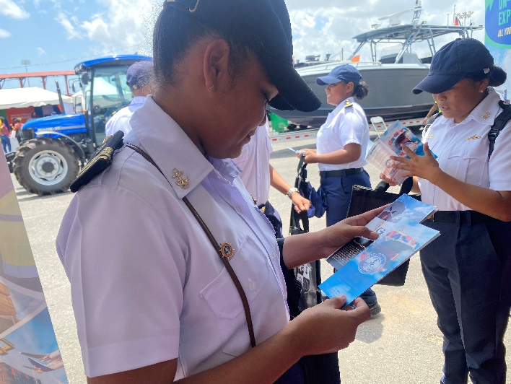

NETWORKING

Slide 20
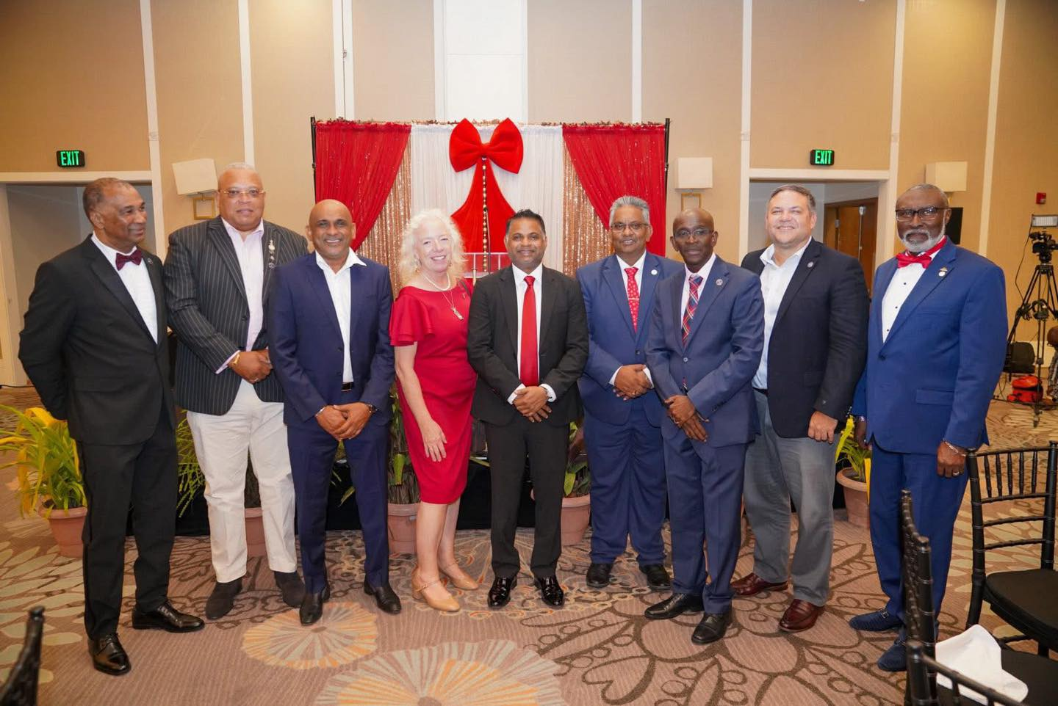
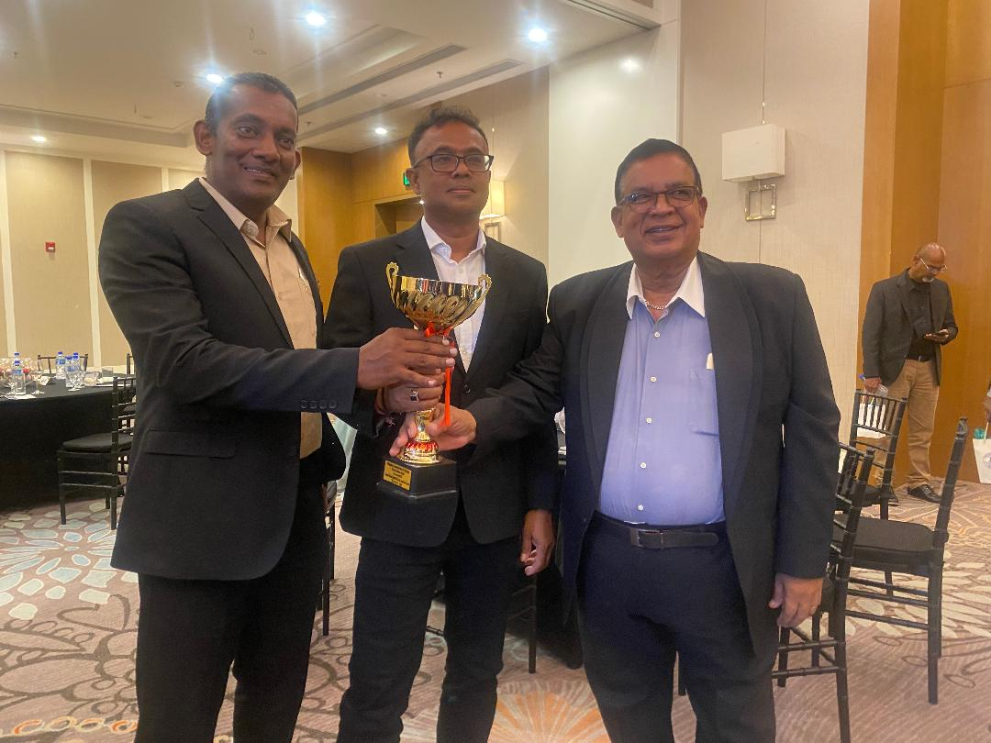
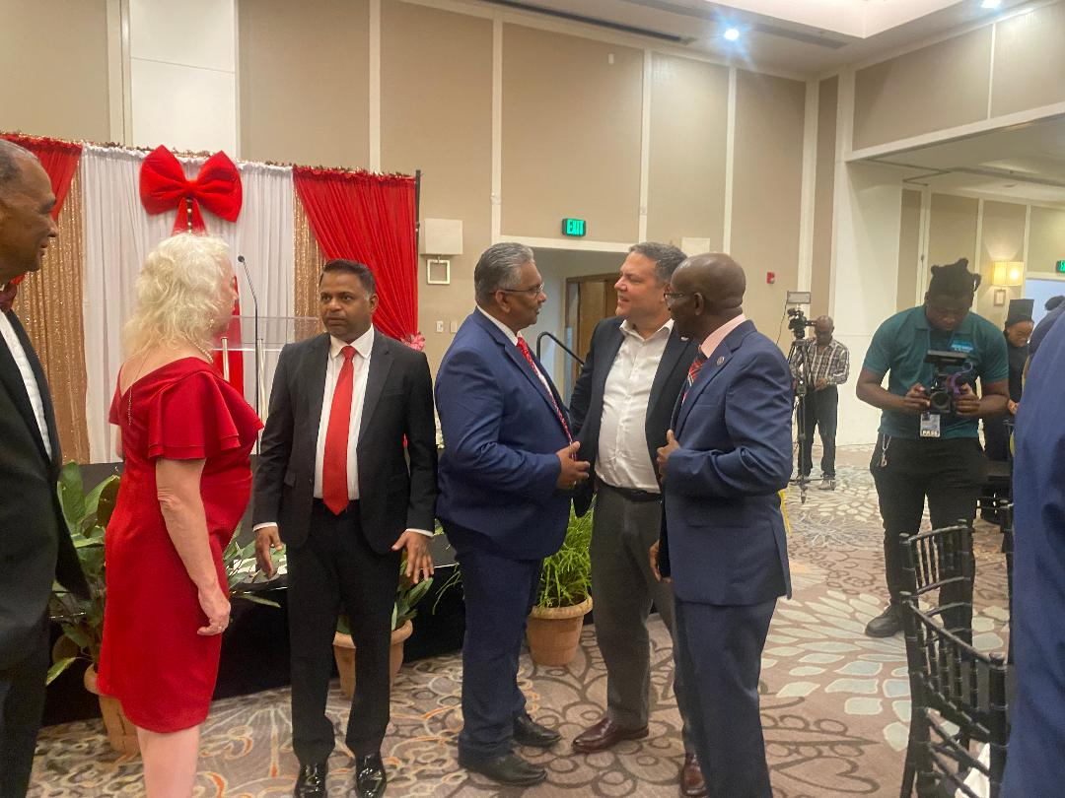
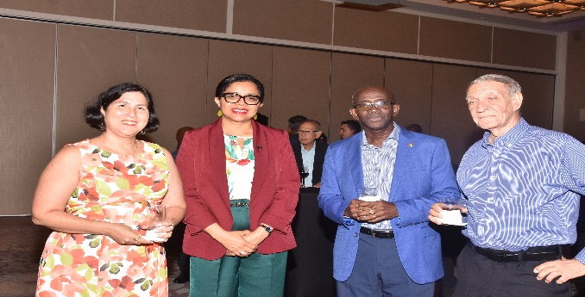

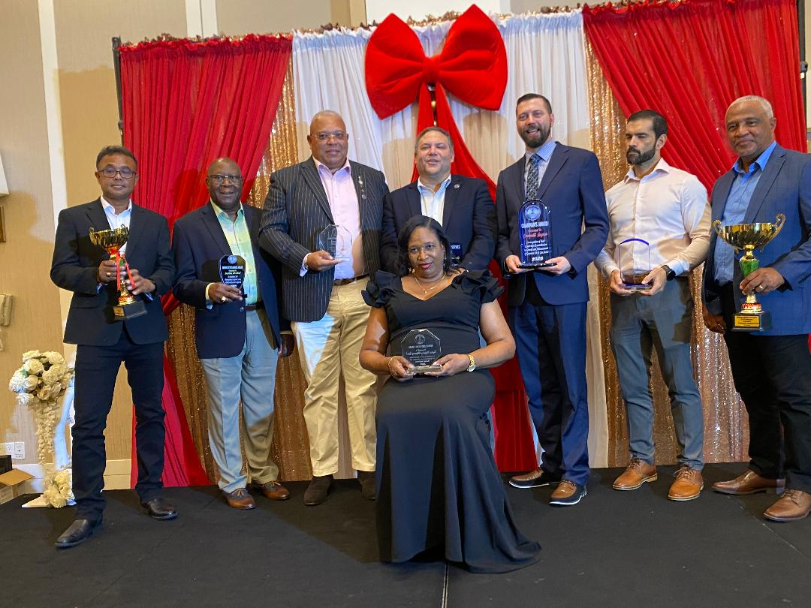
SOCIAL ACTIVITIES

Slide 21

GUYANA REPRESENTED AT CSA
55TH AGM IN SURINAME
Guyana’s delegation was proud to be part of the 55th Annual General Meeting, Conference Exhibition of the Caribbean Shipping Association, October 12-14, 2025 in Suriname. It was a great opportunity to connect, collaborate and advance the regional maritime sector.

Slide 22
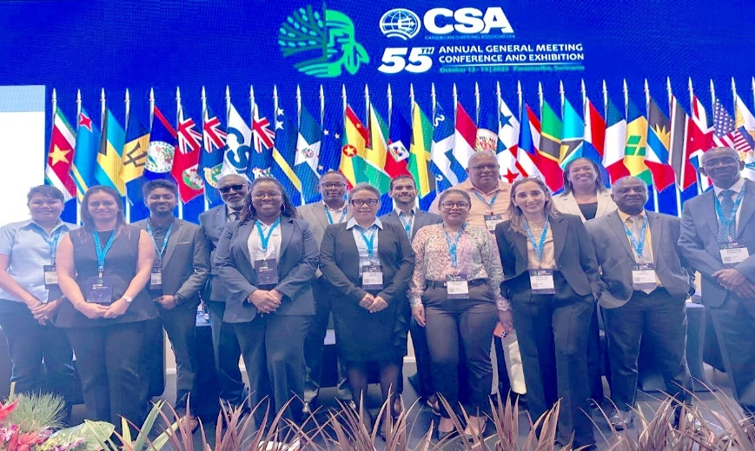
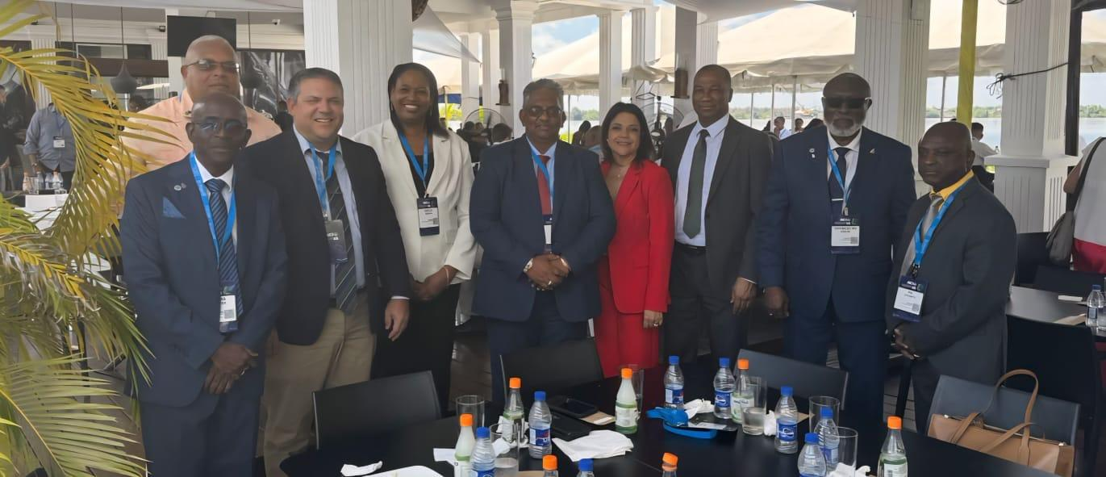
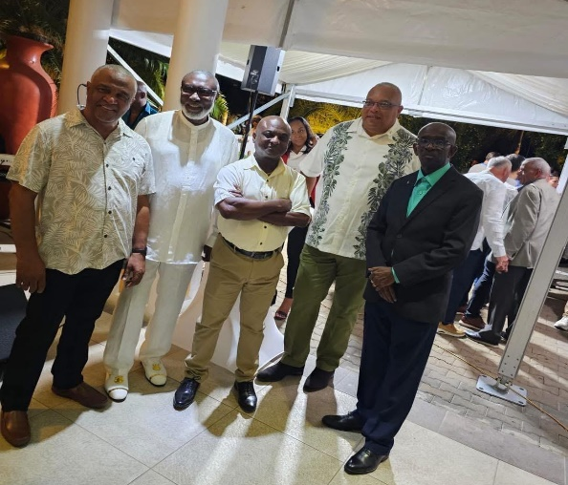


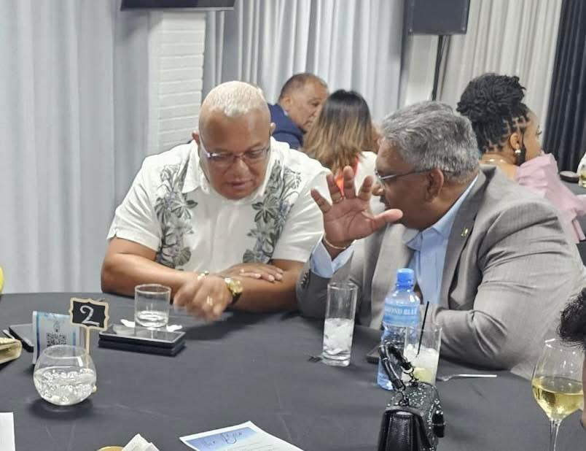

Slide 23

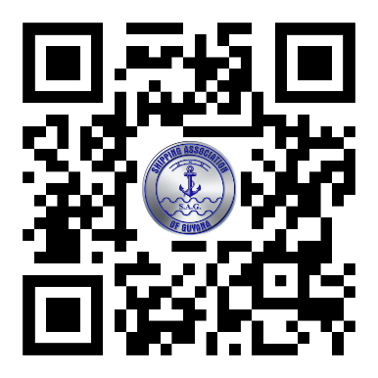


BECOME A MEMBER
CONTACT US:
SECRETARY/MANAGER
TEL: 592-226 2169 /Fax: 592-226 9656
EMAIL: saginc@networksgy.com
Lot 10-11 Lombard St., Werk-en-Rust, Georgetown, Guyana
Website: www.shipping.org.gy

